Slide 1
METHODOLOGY
Interpretation of plan and elevation of the building
Input the dimensions of each of the rooms
Input the different types of openings and assign them to the floor
Input the dimensions of the walls and calculate the amount of brickwork
Select the option for concrete calculation and choose RCC as the evaluation parameter
Generate a report showing the net amount of materials required.
Calculate the embodied energy by multiplying the net amount of quantity of each of the materials with their
All of the above mentioned procedure has been done in the Estimator2.0 software.

Slide 2
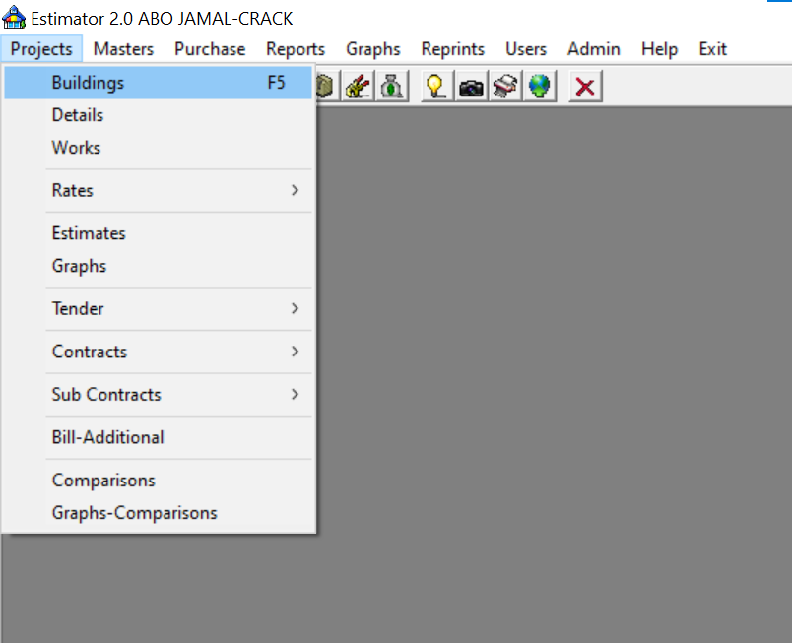
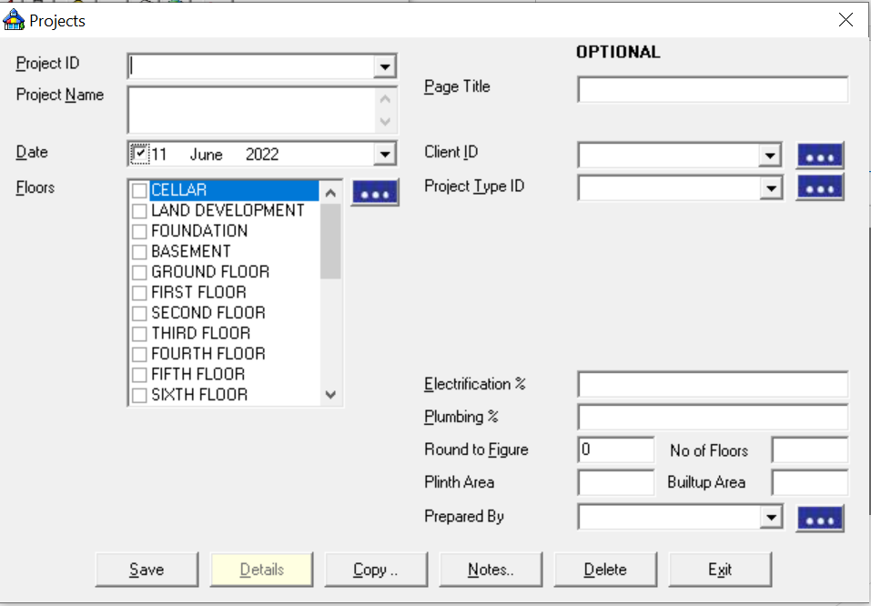
ESTIMATOR 2.0
Creating a new project:
Select the option Buildings from the projects menu.
Then give your project a specific name and a project ID.
After that select the no.of floors from the list that you want to include.
Enter other specifications if necessary.
Click on the save button.

Slide 3
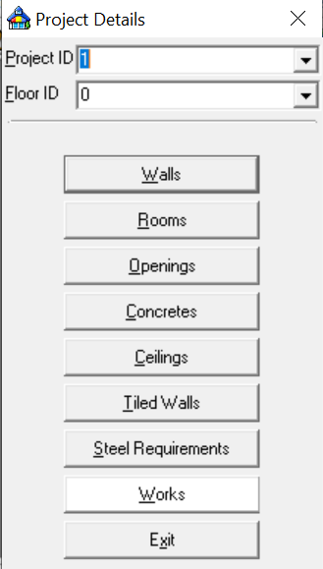
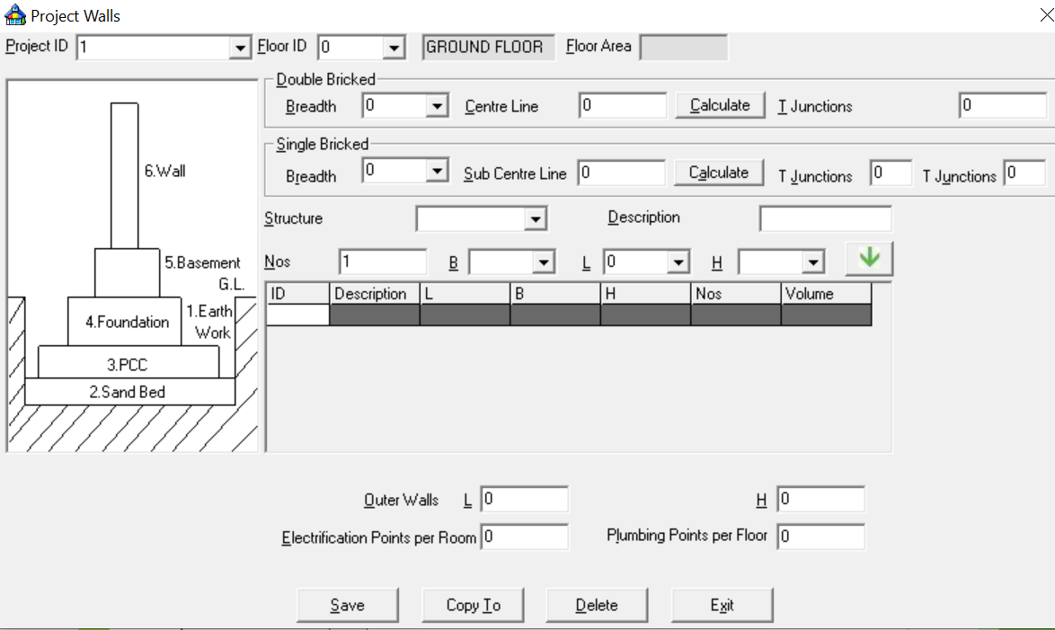
Project Details:
To enter the details of the project select the details from the project menu.
First select the project id and the floor id.
To enter the details of the Walls, click on the walls from the project details window.
Select the breadth and enter the value. You may either enter the length of the main centre line or calculate it from the drawing.
Count the no.of t-junctions in the main junction and enter the value.
Select the type of structure i.e. Walls , put the dimension of the height and then drop the details down to the table by clicking the down arrow button.

Slide 4
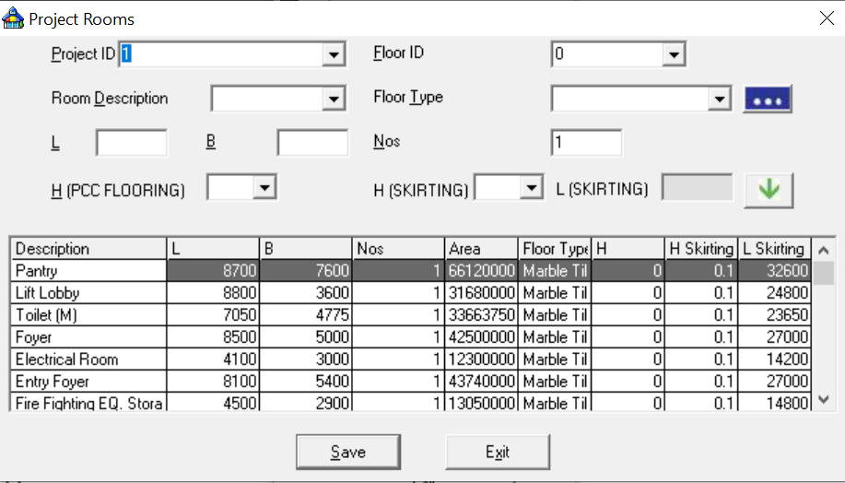
Estimate a room quantity:
To describe a room in a project in a project, click on room button from the project details window.
You can select the room type from the list or you can directly type if it is not in the list.
Select the type of floor used in the building and then input the Length , Breadth and nos .
Enter height of the Skirting . Click on the arrow button to put the details down to the table.

Slide 5
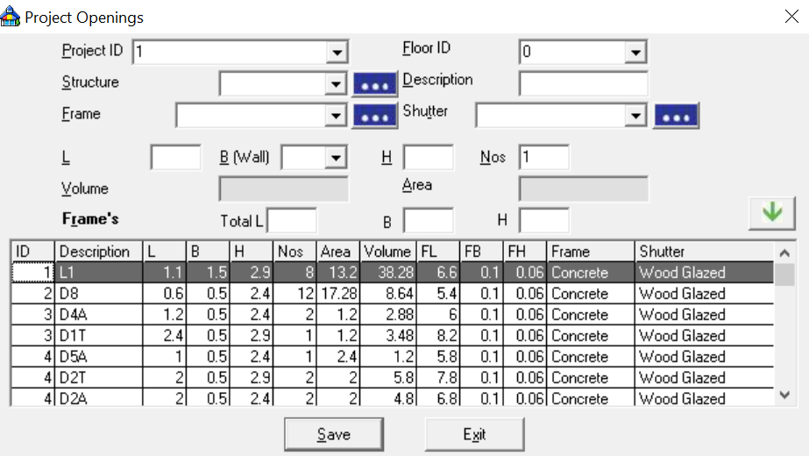
Openings and shutter quantity:
Click openings from the project details window.
Specify the frame types and shutter types from the list. Common types of openings and their dimensions are available in the software.
We have taken the frame type as concrete and Shutter type as Wood Glazed.
Enter the length , height, breadth and nos according to the building plan.’
Drop down the details to the table.
Repeat the process until all the openings have been specified.

Slide 6
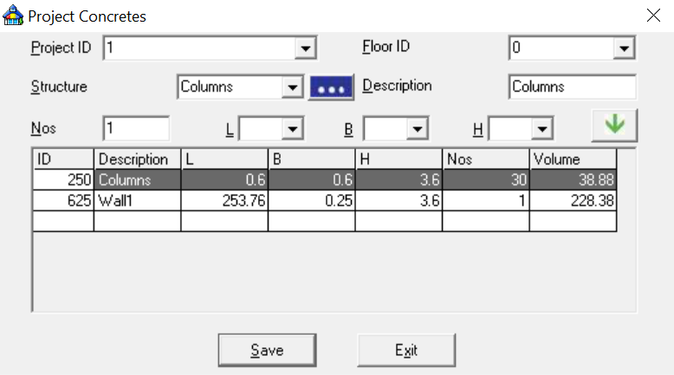
Concrete:
Click on the concrete button from the project details window.
We describe all the Rcc structures like columms.
Enter the length ,breadth and height of the column, also the total number of columns.
Drop down the details down to the table by clicking the green arrow.

Slide 7
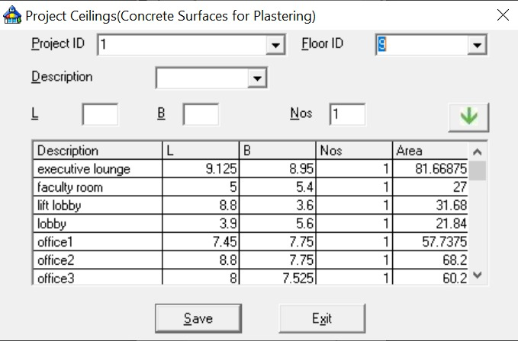
Ceiling
Under the works section, select Ceiling option.
For each of the floor IDs, select the rooms and add all the rooms of the particular floor.
This helps in additional estimation of the cement needed for use of plastering in the ceiling.

Slide 8
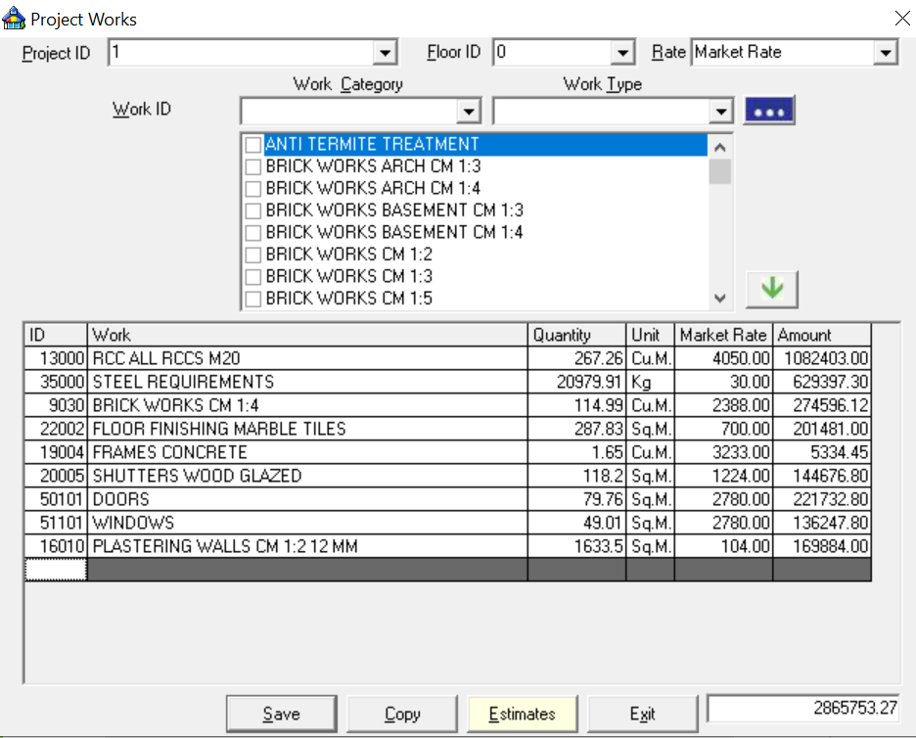
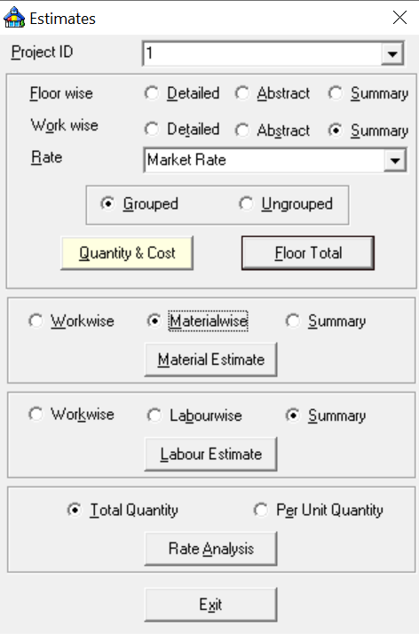
Works:
Select the works form the project details window.
Here we select all the works such as RCC, Steel requirements, brick works cm1:4, floor finishing marble tiles , Frame concrete, Shutters wood glazed, doors and windows and plastering walls cm 1:2 12mm.
All of this works comes under the category of Civil Works.
Save the data and Click on the estimates button.
Then we calculate the summary of all the works (Work wise), select the material estimate option.
And the final report will be displayed on the screen.

Slide 9
Results
The detailed report generated by the Estimator gives the quantity estimate of each material required for all of the G+12 floors of the building.
Embodied Energy of i-th
Construction Material = E_{i}
= Q_{i} * EC_{i}
Where
Q_{i}= Quantity of the i-th material
EC_{i}= Embodied Energy Co-efficient of the i-th material
Material Used | Amount (with unit) | Embodied EnergyCoefficient | Embodied Energy
Ceramic Bricks | 961.13 m³ | 5170 MJ/m³ | 4969042.1 MJ
Cement | 6193.21 m³ | 3200 MJ/m³ | 19818272 MJ
Glass | 14.202 m³ | 40060 MJ/m³ | 568932 MJ
Wood | 92.113 m³ | 388 MJ/m³ | 35739.844 MJ
Ceramic Tiles | 87.7762 m³ | 5250 MJ/m³ | 460825.05 MJ
Stone Ballast | 4727.29 m³ | 1890 MJ/m³ | 8934578 MJ
Sand | 1434.277 m³ | 232 MJ/m³ | 332752.264 MJ
Steel | 381819.34 kg(=48.6394 m³) | 34.8 MJ/kg(=273180 MJ/m³) | 13287313.032 MJ

Slide 10
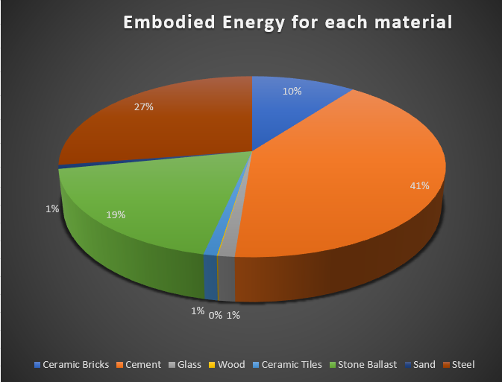
Total Embodied energy of the building = E_{Total}
= ∑Ei=∑(Q_{i}*EC_{i})
The Total Embodied Energy of the Block B, Sister Nivedita University comes out to be 43934454.29 MJ.

Slide 11
Discussion
1) As demonstrated in this study, among the eight investigated
materials, steel is responsible for a significant proportion of energy consumption.
2) The use of building materials with low-embodied energy and CO2 emissions is another key strategy for mitigating the embodied energy and the associated CO2 emissions of commercial and public buildings.
3) An effective strategy for prevention or minimization of construction wastes is shifting from the conventional construction practices to prefabrication of building components.
4) The lack of information on the embodied energy and CO2 emissions of different types of building materials is a big challenge for architects to design buildings with low-environmental impact. Hence, creating an embodied energy and CO2 emissions database for locally produced building materials would be one of the potential strategies to reduce energy
consumption and CO2 emissions of buildings

Slide 12
Conclusion
The methodology developed to estimate the amount of materials using Estimator 2.0 is very simple. This in turn makes it very easy to calculate the indirect embodied energy of a building.
The relative contribution of different individual materials, material composites, building elements and floor levels, in total embodied energy can help to take decision regarding replacement of items while designing an energy efficient structure.
Further studies are also required to comment more conclusively about the durability of the structure and time required for construction using such material alternatives.
The total embodied energy of the building was found out to be 43934454.29 MJ. In this total energy the major components were of Steel (13287313.032 MJ), Cement (19818272 MJ) and Stone Ballast (8934578 MJ). While the minor components were Ceramic Bricks (496042.1 MJ), Glass (568932 MJ), Wood (35739.844 MJ), Ceramic Tiles (460825.05 MJ) and Sand (332752.264 MJ).
In case of the EE coefficient glass had the maximum EE value of 40060 MJ/m3 while Steel having the lowest of 34.8 MJ/kg.

